Slide 1



Cannabis Is Not One Category
RESCHEDULING, RECRIMINALIZATION, AND THE CONTROLS IN BETWEEN
October 29, 2026
10:30am-12:00pm

Slide 2


Steven Kemmerling
Chief Executive Officer
CRB Monitor
Ashley Hess
Vice President & Cannabis Banking Manager
Jonestown Bank & Trust
Steven Kemmerling is the Founder and CEO of CRB Monitor, the leading RegTech platform for cannabis-related business intelligence and compliance. With a database covering over 100,000 private cannabis businesses, 265,000 licenses, and 155,000 decision-makers, CRB Monitor serves as the single source of truth for financial institutions navigating the cannabis sector.
Ashley Hess is the Vice President and Cannabis Banking Manager at Jonestown Bank & Trust Co., a leading community bank. She is a recognized specialist in providing essential financial services, including robust deposit and lending solutions, to licensed and ancillary Cannabis-Related Businesses and Hemp clients. Ashley's strategic vision has not only solidified the bank's presence in PA and the surrounding states but has also expanded its cannabis banking program nationwide. Her expertise is backed by her Certified Cannabis Banking Professional certification from ICS and CBANC, alongside her PBC-I, PBC-II, and PBC-CP credentials from PBC Conference.
Steven pioneered the industry’s risk-tiering framework, first introduced in his 2016 ACAMS Today white paper Defining Marijuana-Related Businesses, which has since become the standard used by banks and regulators nationwide. Before founding CRB Monitor, Steven worked as an M&A investment banker and securities litigation consultant.
Since 2018, Ashley has been at the forefront of Jonestown Bank & Trust Co.'s pioneering efforts to establish transparency and legitimacy within the previously underserved cannabis industry. With a strong foundation of 18 years as a retail banker, Ashley brings extensive traditional banking experience to her specialized and innovative role.
For informational purposes only. All rights reserved. © 2026 CRB Monitor
Notes:
MARIJUANA- ASHLEY NOTES
Accepted medical use and FDA approved products
What about states like CA that no longer really use Medical licensing?
280E and tax reform – more cash flow for lending
Will FinCEN guidance be updated?
Reduced risk – more banks opting into the industry?
Still have implications from examiners

Slide 3
Introduction
Two federal actions have pushed the cannabis sector in opposite directions at the same time.
  In April 2026, DOJ moved state-licensed medical marijuana and FDA-approved products to Schedule III, leaving adult-use and much of the rest in Schedule I pending an administrative ruling.
  Meanwhile, Congress narrowed the federal definition of hemp, and most hemp-derived cannabinoid products are set to move back under the marijuana framework on November 12 and December 11, 2026 — dates that fall within weeks of this conference.
The result is a landscape where CSA compliance hinges on license classification rather than the plant itself, and where a customer you onboarded as a hemp-related business may be a marijuana-related business by year-end.
This session walks through what actually changed, what did not (FinCEN's 2014 guidance and your SAR obligations among them), and where the boundaries are still genuinely unresolved.
THE VIEWS, INFORMATION, OR OPINIONS EXPRESSED DURING THIS PRESENTATION DO NOT CONSTITUTE LEGAL ADVICE AND ARE SOLELY THOSE OF THE SPEAKER AND DO NOT NECESSARILY REPRESENT THOSE OF THE SPEAKER’S COMPANY OR ITS EMPLOYEES.
For informational purposes only. All rights reserved. © 2026 CRB Monitor

Slide 4

PART ONE:
Cannabis Banking 101
INTRODUCTION TO THE SECTOR AND THE EXISTING FRAMEWORKS

Slide 5
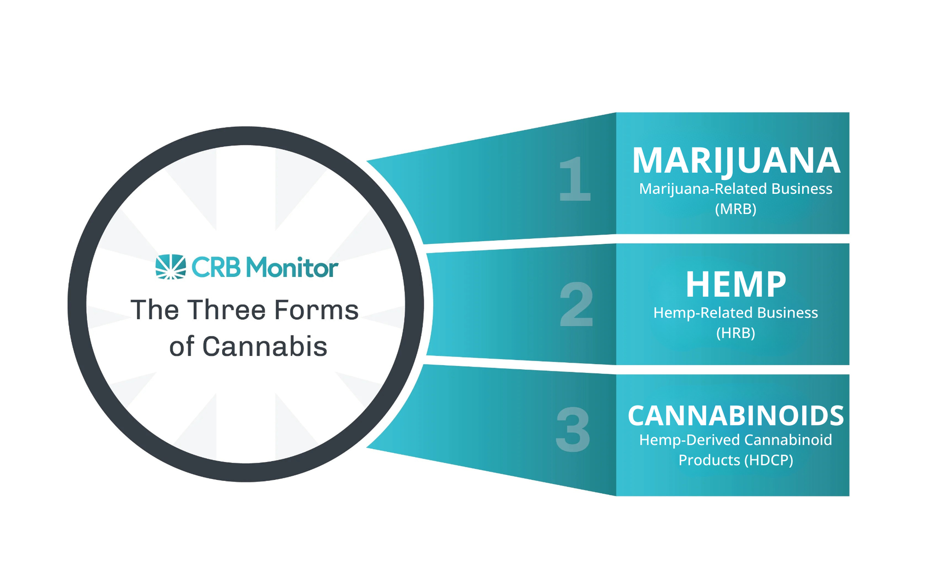
The Cannabis Sector
Each segment has its own unique legal and regulatory differences
For informational purposes only. All rights reserved. © 2026 CRB Monitor

Slide 6

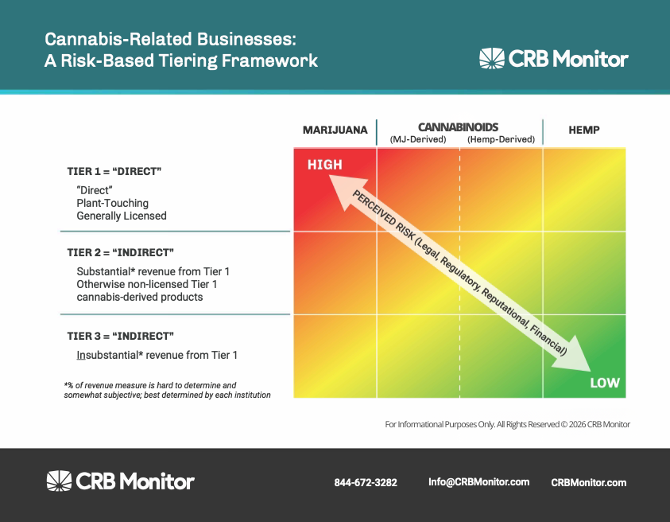

Defining Cannabis-Related Businesses
Risk-Based Tiering Framework (as introduced in 2016 ACAMS Today whitepaper)
These definitions are changing. More on this in Part 2.
For informational purposes only. All rights reserved. © 2026 CRB Monitor

Slide 7
FinCen Guidance & BSA Expectations for Marijuana-Related Businesses
CUSTOMER DUE DILIGENCE
(i) verifying with the appropriate state authorities whether
the business is duly licensed and registered;
(iii) requesting from state licensing and enforcement
authorities available information about the business
and related parties;
(iv) developing an understanding of the normal and
expected activity for the business, including the types
of products to be sold and the type of customers to
be served (e.g., medical vs recreational customers);
(vii) refreshing information obtained as part of customer
due diligence on a periodic basis and commensurate
with the risk or the trafficking of other illegal drugs
or other illegal activity;
RED FLAGS
  A customer appears to be using a state-licensed marijuana-related business as a front or pretext to launder money derived from other criminal activity not permitted under state law.
  A customer seeks to conceal or disguise involvement in marijuana-related business activity.
  The business... are, or have been, subject to an enforcement action by the state or local authorities
  A MRB engages in international or interstate activity
  The owner(s) or manager(s) of a marijuana-related business reside outside the state in which the business is located.
For informational purposes only. All rights reserved. © 2026 CRB Monitor

Slide 8
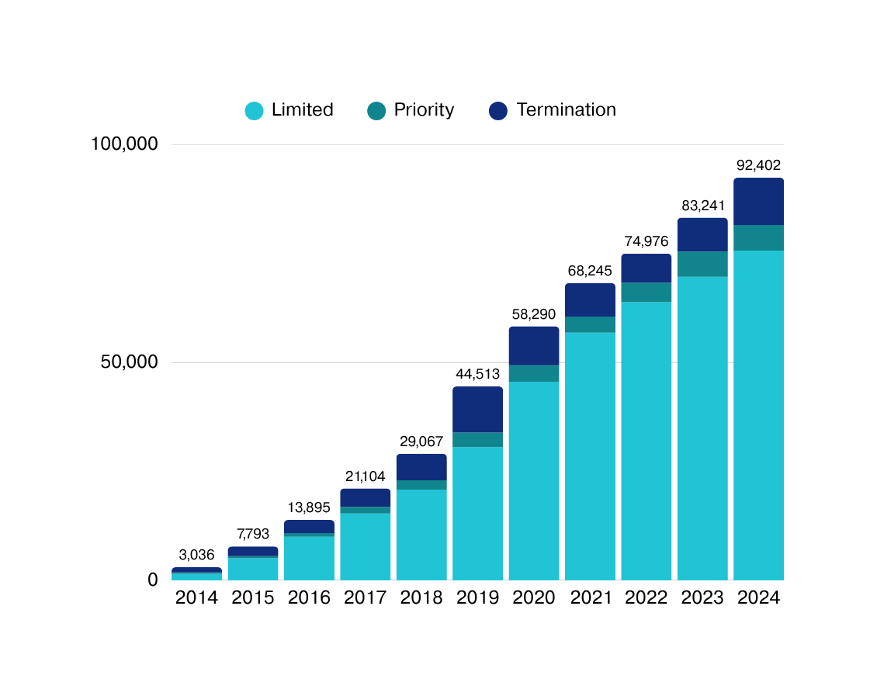

Marijuana-Related Suspicious Activity Reports (SARs)
MARIJUANA LIMITED
Based on due diligence, institution reasonably believes that MRB does NOT implicate one of the Cole Memo priorities or violate state law.
MARIJUANA PRIORITY
Based on due diligence, institution reasonably believes that MRB DOES implicate one of the Cole Memo priorities or violate state law.
MARIJUANA TERMINATION
Based on due diligence, institution reasonably believes that MRB DOES implicate one of the Cole Memo priorities or violate state law.
For informational purposes only. All rights reserved. © 2026 CRB Monitor

Slide 9

Key Considerations for Financial Institutions
PROVIDING FINANCIAL SERVICES TO MARIJUANA-RELATED BUSINESSES
(FIN-2014-G001)
Client Selection & Lifecycle Management
  Geographic Footprint
  Number of Licenses
  Licensing Environment
    Market type (medical, recreational)
    License types
    License statuses
    Data availability
  Type of Business
    Direct (Tier 1) vs. Indirect (Tier 2/3)
    Marijuana vs. Hemp vs. HDCP
“In general, the decision to open, close, or refuse any particular account or relationship should be made by each financial institution based on a number of factors specific to that institution. These factors may include its particular business objectives, an evaluation of the risks associated with offering a particular product or service, and its capacity to manage those risks effectively.
Thorough customer due diligence is a critical aspect of making this assessment.”
For informational purposes only. All rights reserved. © 2026 CRB Monitor

Slide 10
Due Diligence for MRBs
Initial Onboarding
Required Documentation
Application Review & Decision Authority
Ownership & Signers
Site Visits
Vendors/Contractors
SOPs & Policies
Common Onboarding Documentation
  Full Application
    Business info
    Cole Memo attestation
  Business license for each site
  Operating agreements
  Business plans & projections
  Financials (P&L, balance sheet, cash flow)
  Policies & Procedures
  Government IDs
  Tax returns/ personal financial statements
Ongoing EDD
Cannabis Licensing
(new licenses, changes in status)
Negative News &
Enforcement Actions
-“Standard” Screening (ex: OFAC)
-Cannabis-specific
Transaction Monitoring & Deposit Reconciliation
-Suspicious Activity Reports (SARs)
-Cash Transaction Reports (CTRs)
Changes in Ownership
For informational purposes only. All rights reserved. © 2026 CRB Monitor

Slide 11
PART TWO:
Defining & RE-Defining the Cannabis Sector
IMPLICATIONS OF RECENT FEDERAL ACTIONS & REMAINING UNCERTAINTY

Slide 12
Defining Marijuana/Marihuana
Until 2018 Farm Bill; As Defined in Controlled Substances Act (1970)
21 USC 802 - Definitions
 | ABUSE POTENTIAL | MEDICAL USE | SAFETY & DEPENDENCE | EXAMPLES
SCHEDULE I | High | None Currently Accepted | Lack of accepted safety for use under medical supervision | Marijuana, Heroin, LSD, MDMA, Peyote
SCHEDULE II | High | Currently Accepted | Abuse may lead to severe psychological or physical dependence | Cocaine, Methamphetamine, Fentanyl, Adderall, Oxycodone
SCHEDULE III | Less than Schedule I or II | Currently Accepted | Abuse may lead to moderate or low psychological or physical dependence | Ketamine, Steroids, Testosterone, Tylenol with Codeine
SCHEDULE IV | Low potential for abuse, relative to Schedule III | Currently Accepted | Limited physical/ psychological dependence, relative to Schedule III | Xanx, Valium, Ambien
SCHEDULE V | Low potential for abuse, relative to Schedule IV | Currently Accepted | Limited physical/ psychological dependence, relative to Schedule IV | Cough medicines with Codene, FDA-approved drugs containing cannabidiol (CBD)
(16) The term "marihuana" means all parts of the plant Cannabis sativa L., whether growing or not; the seeds thereof; the resin extracted from any part of such plant; and every compound, manufacture, salt, derivative, mixture, or preparation of such plant, its seeds or resin. Such term does not include the mature stalks of such plant, fiber produced from such stalks, oil or cake made from the seeds of such plant, any other compound, manufacture, salt, derivative, mixture, or preparation of such mature stalks (except the resin extracted therefrom), fiber, oil, or cake, or the sterilized seed of such plant which is incapable of germination.
21 CFR 1308.11 - Schedule I
We’ll get “in the weeds” on rescheduling in Part 3
For informational purposes only. All rights reserved. © 2026 CRB Monitor

Slide 13
Defining Hemp
2018 Farm Bill; introduces hemp definition & removes from CSA
AGRICULTURAL MARKETING
ACT OF 1946
CONTROLLED SUBSTANCES ACT
21 USC 802 - Definitions
7 USC 1639o: Definitions
(16)(A) Subject to subparagraph (B), the term "marihuana" means all parts of the plant Cannabis sativa L., whether growing or not; the seeds thereof; the resin extracted from any part of such plant; and every compound, manufacture, salt, derivative, mixture, or preparation of such plant, its seeds or resin.
(B) The term "marihuana" does not include-
(i) hemp, as defined in section 1639o of title 7; or
(ii) the mature stalks of such plant, fiber produced from such stalks, oil or cake made from the seeds of such plant, any other compound, manufacture, salt, derivative, mixture, or preparation of such mature stalks (except the resin extracted therefrom), fiber, oil, or cake, or the sterilized seed of such plant which is incapable of germination.
“(1) Hemp. The term hemp means the plant species Cannabis Sativa L. and any part of that plant, including the seeds thereof and all derivatives, extracts, cannabinoids, isomers, acids, salts, and salts of isomers, whether growing or not, with a delta-9 THC concentration of not more than 0.3% on a dry weight basis.”
Farm Bill led to DEA amending Code of Federal Regulation (CFR 1308.11, adding “marijuana extract” (58) under Schedule I with “marihuana” (23)
Meaning an extract containing one or more cannabinoids that has been derived from any plant of the genus Cannabis, containing greater than 0.3% delta-9-tetrahydrocannabinol on a dry weight basis, other than the separated resin (whether crude or purified) obtained from the plant.
For informational purposes only. All rights reserved. © 2026 CRB Monitor

Slide 14
RE-Defining Hemp: What We DO Know
2025; Re-opening the government, closing the “hemp loophole”
2018
November 12, 2025
H.R.5371 - Continuing Appropriations, Agriculture, Legislative Branch, Military Construction and Veterans Affairs, and Extensions Act
U.S. Agriculture Improvement Act
(AKA The Farm Bill)
‘‘(A) IN GENERAL.—The term ‘hemp’ means the plant Cannabis sativa L. and any part of that plant, including the seeds thereof and all derivatives, extracts, cannabinoids, isomers, acids, salts, and salts of isomers, whether growing or not, with a total tetrahydrocannabinols concentration (including tetrahydrocannabinolic acid) of not more than 0.3 percent on a dry weight basis.
“(1) Hemp. The term hemp means the plant species Cannabis Sativa L. and any part of that plant, including the seeds thereof and all derivatives, extracts, cannabinoids, isomers, acids, salts, and salts of isomers, whether growing or not, with a delta-9 THC concentration of not more than 0.3% on a dry weight basis.”
EXCLUDES... Any intermediate or final hemp-derived cannabinoid products with:
  Cannabinoids not produced naturally in the plant;
  Cannabinoids capable of being produced naturally in the plant, but synthesized outside the plant;
  Products with more than 0.3% combined total (for intermediate products) or 0.4mg total per container (for final products) of:
    Total THC (including THCa)
    Any other cannabinoids with similar effects, or marketed to have similar effects (as determined by HHS)
For informational purposes only. All rights reserved. © 2026 CRB Monitor

Slide 15

RE-Defining Hemp: What We Don’t Know
Open questions the FDA still has to answer
Congress directed the FDA to publish cannabinoid lists and clarify “container” within 90 days of enactment (by Feb. 10, 2026). Neither action has been delivered — leaving the operating definition of the new rule unsettled and only a few months left until effective date.
THE CANNABINOID LIST
“CONTAINER” DEFINITION
Which compounds count as “THC” or having “similar effects”?
The 0.4 mg limit is per container-- but what counts as one?
  All cannabinoids naturally produced by Cannabis sativa L
  All THC-class cannabinoids known to occur in the plant
  All other cannabinoids with (or marketed as having) similar effects to THC
  Open: does the list sweep in CBN, THCV, HHC — or even CBD?
  Statute: “innermost wrapping in direct contact” at retail (jar, bottle, bag, packet, cartridge)
  Is a bag of 30 gummies one container — or is each wrapped gummy its own?
  Multi-pack beverages, tinctures with droppers, pre-roll tubes?
  Open: FDA guidance on “additional specificity” never issued.
For informational purposes only. All rights reserved. © 2026 CRB Monitor

Slide 16
Navigating uncertainty: HEMP
What can we do? What should we consider?
  Update risk assessments
  Exit portfolio that is nonindustrial purposes (cannabinoids)
  Reassess high risk status for noncompliance – are there SAR implications?
  Credit and collateral – review loan covenants
But what if something changes again?
Financial institutions can’t wait until the last minute to prepare, despite the details not coming until the last minute.
For informational purposes only. All rights reserved. © 2026 CRB Monitor
Notes:
ASHLEY NOTES:
If nothing changes – what do we do?
Definition of hemp
update risk assessments
exit portfolio that is nonindustrial purposes (cannabinoids)
reassess high risk status for noncompliance – is there SAR implications?
Credit and collateral – review loan covenants
If it does change or extend
Can’t wait until the last minute despite the rules waiting until the last minute

Slide 17
Implications of New Hemp Definition
FinCEN's 2020 guidance hasn't been rescinded, but it only ever protected businesses that are hemp under federal definition and federal legality.
On the effective date, a customer selling delta-8, THCA flower, or high-dose delta-9 edibles is no longer a hemp-related business — it's a marijuana-related business, and the 2014 Marijuana Guidance framework governs how to be compliant, if you keep the relationship at all.
License verification alone is increasingly insufficient.
Prioritize sector segmentation.
The technical boundaries remain blurry.
A valid USDA or state grower license answers a question about the plant, not about the finished product.
Post-effective-date diligence has to reach product formulation, cannabinoid derivation method (naturally occurring vs. synthesized/converted), and per-container total THC on COAs run under total-THC methodology.
That's a different documentation package than what most hemp CDD procedures currently call for.
The exposure isn't uniform.
Fiber, grain, and true industrial hemp are largely protected. Intoxicating products are almost certainly captured.
The uncomfortable middle is non-intoxicating CBD: the 0.4 mg per-container cap threatens full-spectrum extracts and wellness products containing only trace THC, and industry estimates put roughly 95% of existing hemp-derived cannabinoid products outside the new definition. Indirect exposures are another challenge to capture.
The FDA hasn’t provided required clarification.
FDA was required to publish, within 90 days of enactment, lists of cannabinoids naturally producible by the plant, THC-class cannabinoids, and other cannabinoids with similar effects — and as of August 2026, those have not been published. The "container" clarification is outstanding too. Also note HHS can designate additional "similar effect" cannabinoids later, so a product that clears today can fail after a future listing. Build re-review triggers into monitoring rather than treating compliance determinations as static.

Slide 18


Guidance on Hemp-Related Businesses
In Dec. 2019, FRS, FDIC, FinCEN, OCC & CSBS issued an interagency statement explaining that “Because hemp is no longer a Schedule I controlled substance under the Controlled Substances Act,” banks are not required to file a Suspicious Activity Report (SAR) on customers solely because they are engaged in the growth or cultivation of hemp in accordance with applicable laws and regulations. For hemp-related customers, banks are expected to follow standard SAR procedures, and file a SAR if indicia of suspicious activity warrants.
Due Diligence Requirements under the Bank Secrecy Act for Hemp-Related Business Customers
NCUA Additional Guidance Regarding Servicing Hemp-Related Businesses
FIN-2020-G001 (June 2020)
20-CU-19 / June 2020 (Modified Dec. 2025)
  Core control is licensure verification — a copy of the license or a written attestation, supplemented risk-based with crop inspection/testing reports, license renewals, and updated attestations or correspondence with the state, tribe, or USDA.
  Monitor transactions like any other customer. SAR triggers include a customer apparently producing hemp in a jurisdiction where it remains illegal.
  Commingling rule: if hemp and marijuana proceeds are mixed, apply the 2014 Marijuana Guidance to the whole relationship. If proceeds are segregated or otherwise identifiable, the 2014 guidance (and marijuana SAR filing) applies only to the marijuana side.
  Sufficient CDD to reasonably ensure member businesses producing or selling hemp products comply with applicable law
  Verify growers hold a valid state or USDA license. However, credit unions are not the enforcement authority policing the industry.
  Stay alert to illicit or unusual activity and file SARs under normal BSA/AML standards.
Guidance hinges on federal legality under the federal definition of hemp.
For informational purposes only. All rights reserved. © 2026 CRB Monitor

Slide 19
RE-Scheduling “Marijuana”
Partial Rescheduling per DOJ Final Order : “State-Licensed Medical” & FDA Medical
21 CFR 1308.11 -- Schedule III
Resulting Changes
(g) Hallucinogenic substances
  Adds definition for “state medical marijuana license” to 21 CFR 1300.01
  “Marijuana” as outlined under Schedule III now included on list of non-narcotic controlled substances that “have been specifically designated by the Administrator of the Drug Enforcement Administration as requiring import and export permits” [21 CFR 1213.30]
  “Marihuana” and “marihuana extract” remain in Schedule I under 21 CFR 1308.11... for now.
(2) Marijuana, as defined in 21 U.S.C. 802(16), in a U.S. Food and Drug Administration approved product or subject to a state medical marijuana license
(3) Marijuana extract, as defined in 21 CFR 1308.11(d)(58), in a U.S. Food and Drug Administration approved product or subject to a state medical marijuana license
(4) Naturally derived delta-9-tetrahydrocannabinols in a U.S. Food and Drug Administration approved product or in marijuana subject to a state medical marijuana license
State medical marijuana license means a license issued by a state entity (or by a District of Columbia entity or a federal territorial entity) authorizing the licensee to manufacture, distribute, and/or dispense marijuana or products that contain marijuana for medical purposes.
(i) Naturally derived delta-9-tetrahydrocannabinols means those delta-9-tetrahydrocannabinols, except as in paragraphs (g)(2) and (3) of this section, that are naturally contained in a plant of the genus Cannabis (cannabis plant).
(ii) Naturally derived delta-9-tetrahydrocannabinols do not include any material, compound, mixture, or preparation that falls within the definition of hemp set forth in 7 U.S.C. 1639o.
(iii) Naturally derived delta-9-tetrahydrocannabinols do not include any delta-9-tetrahydrocannabinols contained in substances excluded from the definition of marijuana as set forth in 21 U.S.C. 802(16)(B)(ii).
AG Order No. 6754-2026
For informational purposes only. All rights reserved. © 2026 CRB Monitor

Slide 20
RE-Scheduling “Marijuana”
June-July Rescheduling Hearings & Motion for Stay
  Landmark administrative hearing on whether to move all marijuana (including “Adult-Use” 0 from Schedule I to Schedule III of the CSA
    11 day hearing; Ran June 29–July 15 , 2026 , with a July 3 recess
    Presided over by DEA Chief Administrative Law Judge (ALJ) Derek Julius
  August 17 , DEA is formally urged the ALJ recommend moving all marijuana from Schedule I to Schedule III
    ALJ is required “as soon as practicable” to prepare a report containing recommended rulings.
    August 25, more than 2,500 pages of transcripts releases
  September 23, U.S. Government Accountability Office pubilshed a reoprt highlighting gaps in DEA/HHS policies,
    “Drug Scheduling: While DEA Decisions Have Aligned with Recent HHS Recommendations, Both Need Comprehensive Policies”
  September 29, ALJ granted motion for a stay that was filed by three of the (anti-rescheduling) “interested parties” from the hearing based on findings from the GAO report
  October 13, deadline for DEA to file a response to the motion
For informational purposes only. All rights reserved. © 2026 CRB Monitor

Slide 21
QUICK RECAP
Cannabis is not a monolithic category. Each form has its own distinct legal and regulatory differences, each with its own implications for assessing risk.
HEMP
  Prior to 2018, hemp fell under the federal definition of “marihuana”, a Schedule I Substance under the Controlled Substances Act (CSA)
  The 2018 Farm Bill removed hemp from the CSA and introduced an (overly broad) definition of hemp that created a “loophole” for intoxicating and synthetic cannabinoid products
  In November 2025, Congress passed legislation to update the hemp definition and ban most hemp-derived cannabinoid products (HDCPs)
  HDCPs – synthetic & intoxicating – will be considered Schedule I
MARIHUANA/MARIJUANA
  The CSA classified “marihuana” as Schedule I since it was enacted
  In April 2026, the DOJ resclassified 2 types of marijuana – state-licensed medical marijuana and FDA approved marijuana products – WITH DEA registration as Schedule III
  “The remainder” of marijuana remains in Schedule I...for now.

Slide 22
PART THREE:
What Rescheduling Does & Doesn’t Do
FEDERAL REGULATORY FRAMEWORK & ENFORCEMENT ROLES

Slide 23








Federal Landscape
Key Players & Policies Related to Cannabis Compliance
Dept. of Health & Human Services (HHS)
Dept. of the Treasury
Dept. of Justice (DOJ)
The Cole Memo
FOOD & DRUG ENFORCEMENT AGENCY (FDA)
INTERNAL REVENUE SERVICE (IRS)
FINANCIAL CRIMES ENFORCEMENT NETWORK (FINCEN)
DRUG ENFORCEMENT AGENCY (DEA)
Food Drug & Cosmetics Act (FDCA)
Internal Revenue Code
Bank Secrecy Act (BSA)
Controlled Substances Act (CSA)
FIN-2014-G001
For informational purposes only. All rights reserved. © 2026 CRB Monitor

Slide 24

Rescheduling Implications:
Bank Secrecy Act
Financial Crimes Enforcement Network, Guidance FIN-2014-G001, BSA Expectations Regarding Marijuana-Related Businesses (Feb. 14, 2014)
“Because federal law prohibits the distribution and sale of marijuana, financial transactions involving a marijuana-related business would generally involve funds derived from illegal activity.
Therefore, a financial institution is required to file a SAR on activity involving a marijuana-related business (including those duly licensed under state law), in accordance with this guidance and FinCEN’s suspicious activity reporting requirements and related thresholds.”
The FinCEN framework was designed to enforce the Bank Secrecy Act (BSA), not to enforce the Controlled Substances Act (CSA) directly.
For informational purposes only. All rights reserved. © 2026 CRB Monitor
For informational purposes. All rights reserved © 2026 CRB Monitor.

Slide 25
Rescheduling Implications: Food, Drug & Cosmetics Act
April DOJ Rule references 21 CFR 1318.04(b), stating that “medicinal cannabis” is exempt from the requirement to monopolize the wholesale trade.
Per 21 CFR 1318.02(b) “medicinal cannabis” is “a drug or product made from the cannabis plant, or derivatives thereof, that can be legally marketed under the Federal Food, Drug, and Cosmetic Act.”
CSA Compliant does NOT mean legal. Because state licensed medical marijuana lacks formal FDA approval, it appears to remain illegal under the FD&C Act
Additionally, per Gov. Exhibit 1 (May 2024 NPRM) :
  Any drugs containing a substance within the CSA's definition of “marijuana” would also remain subject to the applicable prohibitions in the Federal Food, Drug, and Cosmetic Act (“FDCA”)”
  It also specifies that the recommendation of Schedule III “was not meant to be, nor is it, a determination of safety and efficacy under the Federal Food, Drug, and Cosmetic Act’s drug approval standard for new human or animal drugs”
For informational purposes. All rights reserved © 2026 CRB Monitor.

Slide 26
Rescheduling Implications: Tax Code
Beyond 280e; Defining “illegal payment”
While Schedule III classification of cannabis DOES remove the application of 280E from cannabis businesses, this does not mean that CRBs will automatically be able to deduct business expenses...or that the IRS is obligated to make it easy.
26 U.S. Code § 162(c)(2) : Other Illegal Payments
No deduction shall be allowed under subsection (a) for any payment... if the payment constitutes an illegal bribe, illegal kickback, or other illegal payment under any law of the United States, or under any law of a State (but only if such State law is generally enforced), which subjects the payor to a criminal penalty or the loss of license or privilege to engage in a trade or business.
The IRS is bound to the Internal Revenue Code, which is written by Congress, not other agencies.
When the DEA reschedules a substance, the
IRS tax code may need to change which prompts the IRS to issue updated guidance to reflect this change in the underlying law.
Section 7212 of the IRC protects the IRS from political interference.
For informational purposes. All rights reserved © 2026 CRB Monitor.

Slide 27
Legal Paradox
FEDERAL SCHEDULE
FEDERAL STATUS
STATE LEGALITY
Regulatory Reference Guide
AS OF SEPTEMBER 2, 2026
Adult-use marijuana
Legal in
Schedule I
Illegal
Varies
State-licensed recreational
Legal in 23 states & 3 territories
  With partial rescheduling, CSA status now hinges on license type, not just the underlying plant material.
  Schedule III does NOT equal legal
  State law continues to govern day-to-day operations — federal rules are waived where state law applies.
  Hemp-derived cannabinoids are on a clock — December 11, 2026 brings HDCPs under the marijuana framework.
Medical marijuana
CSA Compliant, Not FD&C Compliant = Illegal
Varies
Schedule III
Legal
State license + DEA-registered
Legal in 42 states, D.C. & 4 territories
Medical marijuana
Varies
State-licensed, no DEA registration
Schedule I
Illegal
Legal in 42 states, D.C. & 4 territories
FDA-approved drugs
Pharmaceutical pathway
Schedule III
Legal
Legal
Hemp-derived cannabinoids
Pending Schedule I/ Merger into Marijuana
Pending Illegal
Varies
Delta-8 and similar derivatives
For informational purposes only. All rights reserved. © 2026 CRB Monitor

Slide 28
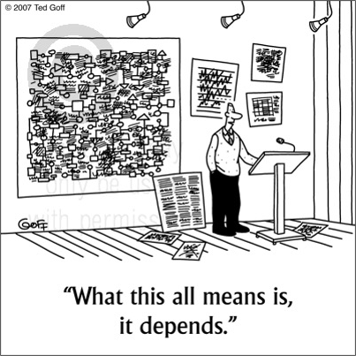
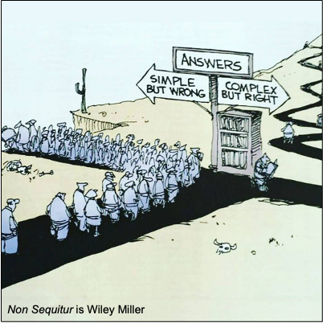
It’s Complicated... and Changing Real-Time
For informational purposes. All rights reserved © 2026 CRB Monitor.
Notes:
This is a long time coming.
The DEA has a page on Notice of Proposed Rulemaking for Rescheduling Marijuana that contains 54 documents, going back as far as 2016.
https://www.dea.gov/notice-proposed-rulemaking-nprm

Slide 29

QUESTIONS?
Steven Kemmerling
Ashley Hess
Founder & Chief Executive Officer
VP & Cannabis Banking Manager
sales@crbmonitor.com
ahess@jbt.bank
THE VIEWS, INFORMATION, OR OPINIONS EXPRESSED DURING THIS PRESENTATION DO NOT CONSTITUTE LEGAL ADVICE AND ARE SOLELY THOSE OF THE SPEAKER AND DO NOT NECESSARILY REPRESENT THOSE OF THE SPEAKER’S COMPANY OR ITS EMPLOYEES.

